Slide 1


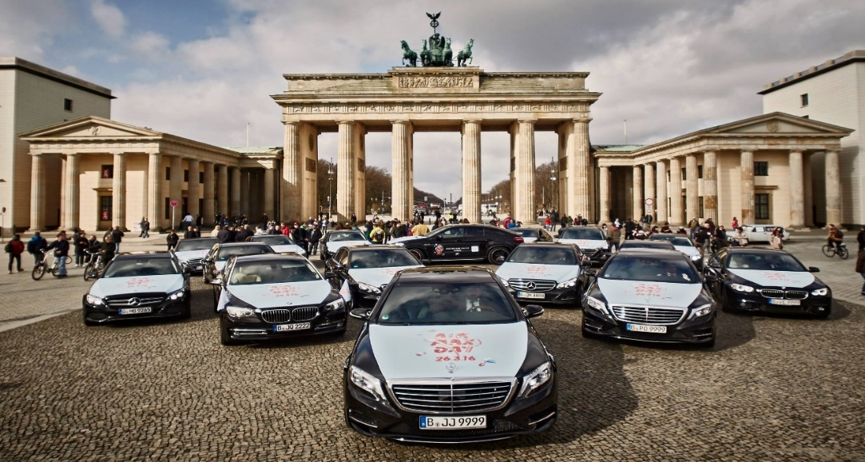
Battle of Neighborhood's
Finding The Best Pivot Area For Cab Drivers in Berling.
By Guray CERMAN
IBM Professional Data Science Certification Coursera Capstone Project .

Slide 2
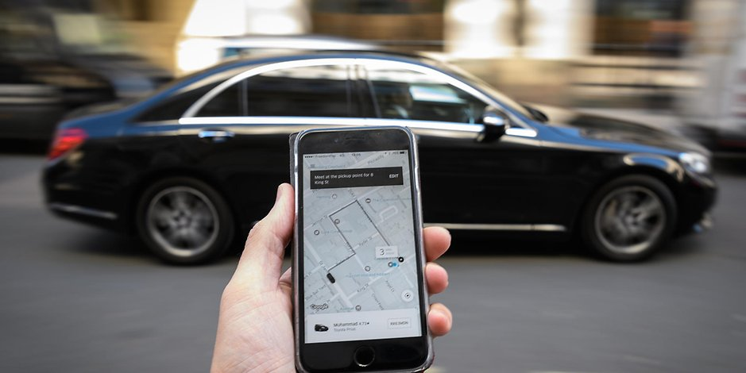
Table of Contents
Introduction: Business Problem
Data
Methodology
Results
Discussion
Conclusion

Slide 3
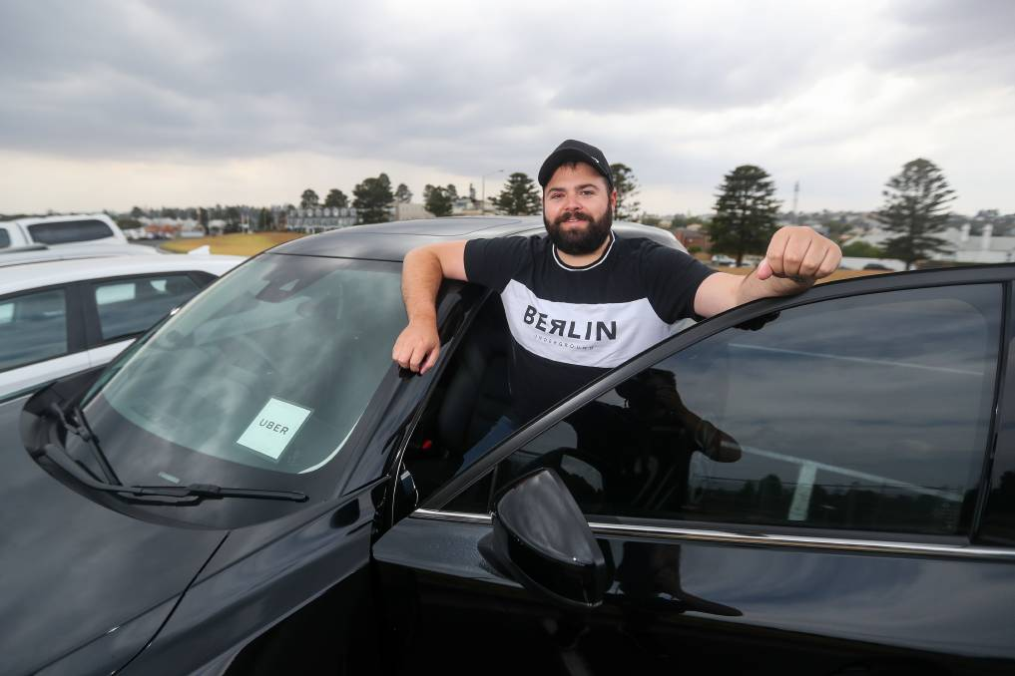
Introduction: Business Problem
A person wants to dive into taxi business in Berlin. He wants to be a non-conventional cab driver and work independently as a member of UBER or MyTaxi organizations. He has a limited budget and he wants to maximize his profits.
At this point, we want to help him by determining a pivot area in Berlin where he can easily find clients and minimize his costs of driving without a client, in due course.
Taxi Business

Slide 4
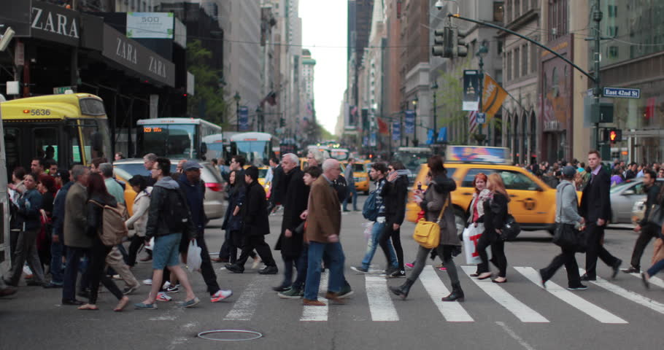
Introduction: Business Problem
People commute in metropoles based on patterns.
Season (sommer, winter etc),
The day type (weekday or weekend),
The time period of the day (morning, noon, afternoon, night) has great effect on these patterns.
Movement Patterns of People

Slide 5

Introduction: Business Problem
Daily Routine;
From Home to Work,
From work to Home,
From work to recreation areas or venues,
From venues to Home
Weekends;
From homes to recreation areas or venues,
Vice versa
Sommer period;
From hotels to touristic areas,
Vice versa
Movement Patterns of People
Venues

Slide 6
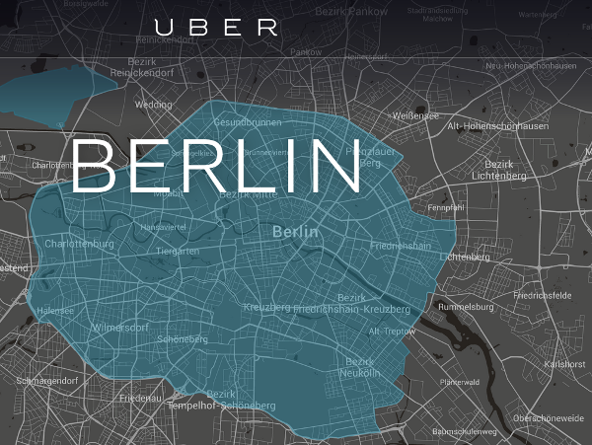
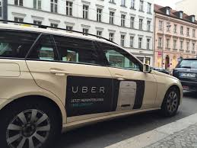
Introduction: Business Problem
Non-conventional taxi business : UBER and MyTaxi,
Both work online on applications
The algorithm directs cabs to cab calling clients based on finding nearest available cab.
Non Conventional Taxi Business
Venues
More Clients
Finding best pivot area for cabs helps !!!

Slide 7
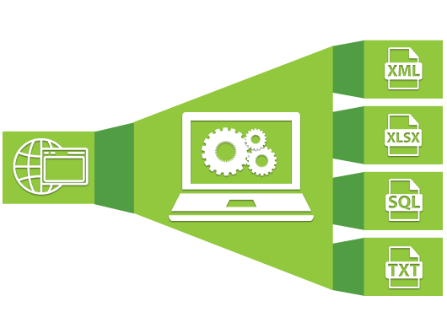
Data : Sources /Web Scraping
REQUIREMENTS
List of all the boroughs in Berlin with all zipcodes belonged to this boroughs
Geopraphical positions (Latitude-Longitude) of all zipcodes within these boroughs
List of all venues in boroughs
List of Top rated Venues
SOURCE
http://www.statistik-berlin-brandenburg.de/produkte/verzeichnisse/zuordnungderbezirkezupostleitzahlen.xls
https://raw.githubusercontent.com/TrustChainEG/postal-codes-json-xml-csv/master/data/DE/zipcodes.de.csv
https://raw.githubusercontent.com/m-hoerz/berlin-shapes/master/berliner-bezirke.geojson
Foursquare API
For all Venues in Berlin.
YELP API
For top rated Venues in Berlin.

Slide 8
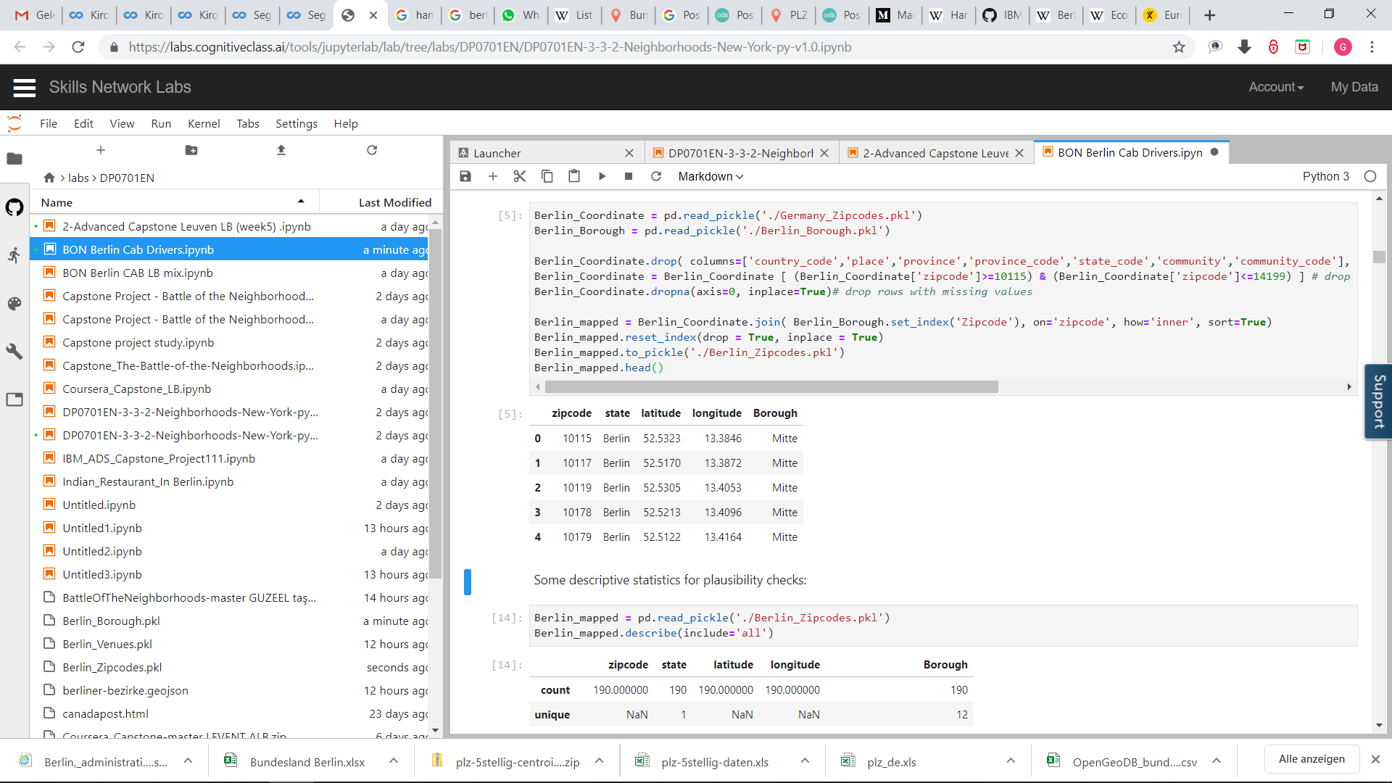
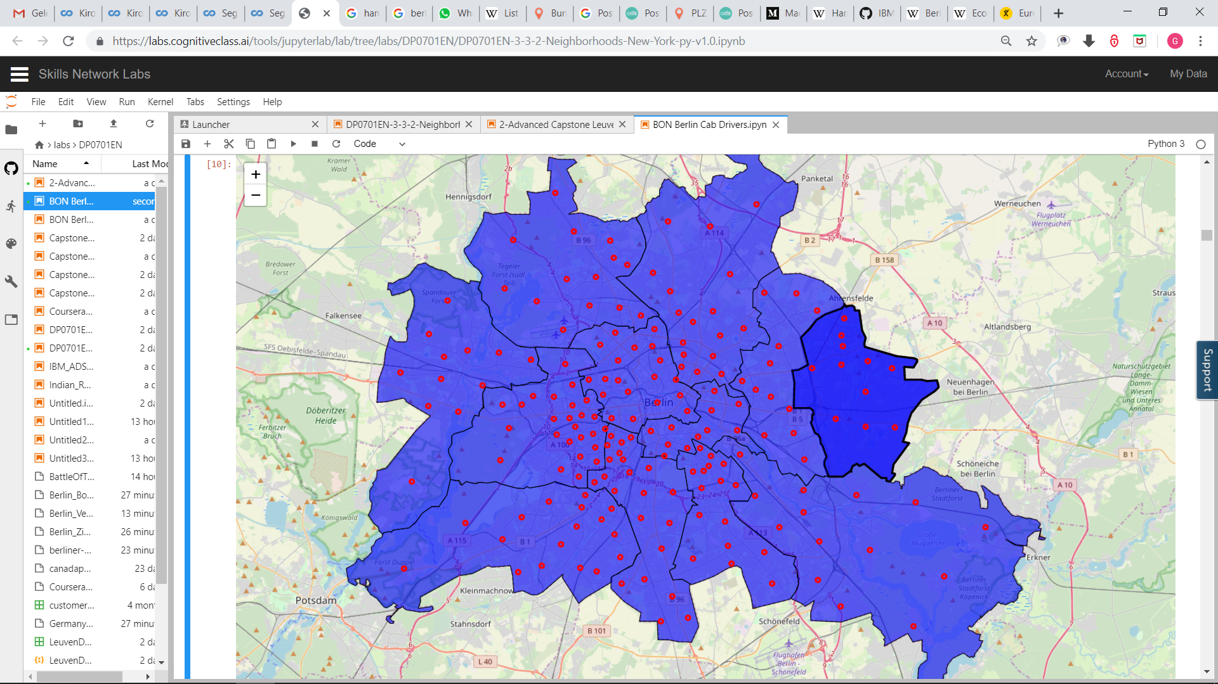
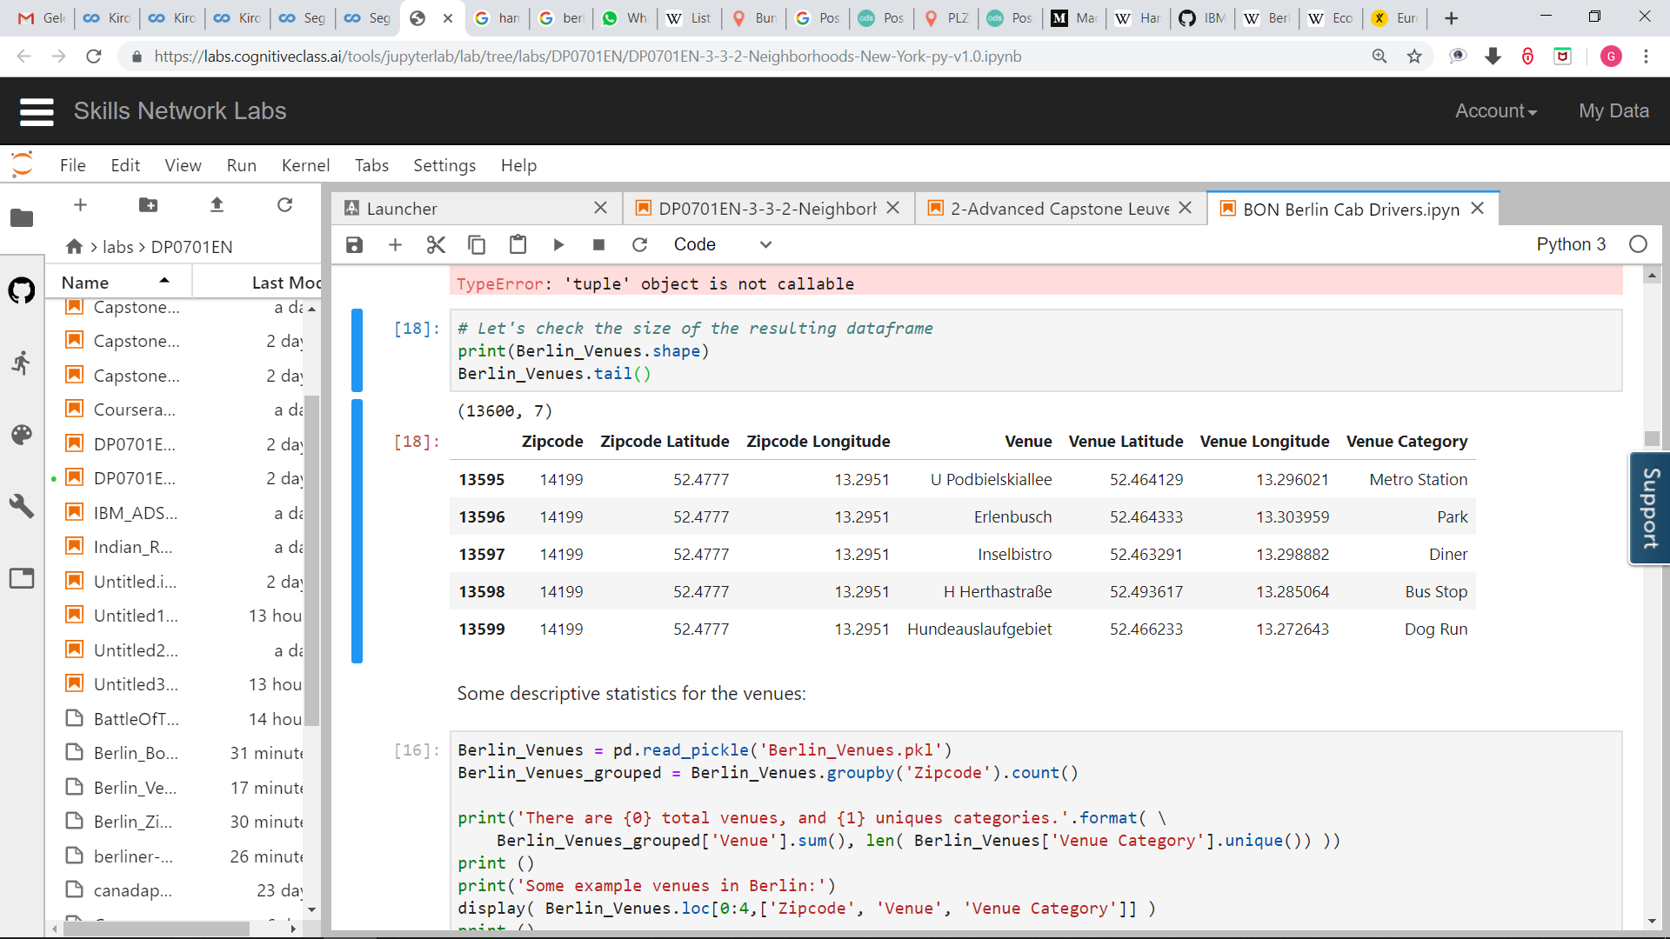
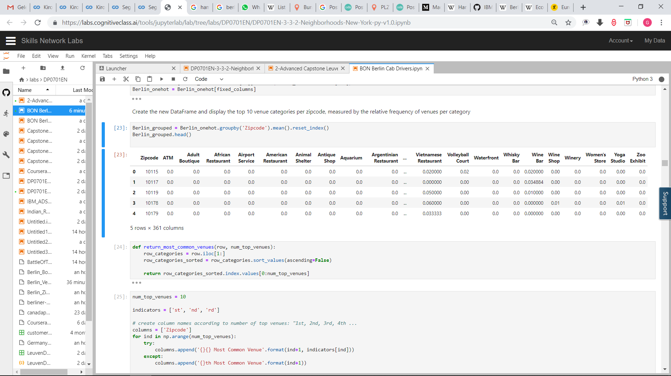
Data : Data Wrangling
Boroughs and Neighbourhoods of Berlin

Slide 9
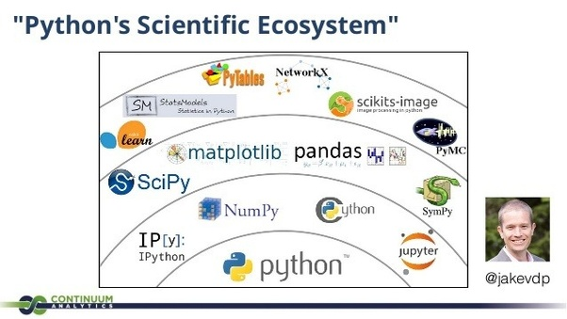
Data : Python Libraries
Pandas, Numpy – Libraries for data storage, manipulation and array computing
Scipy – Library for dendrogram and hierarchical cluster analysis
Matplotlib, Folium – Libraries for representing numeric and locational data
Geopy – Library to retrieve locational data
Json – Library to handle JSON files
Requests, Urllib – Libraries to retrieve data and handle http exchange with the Foursquare API and Yelp API.

Slide 10

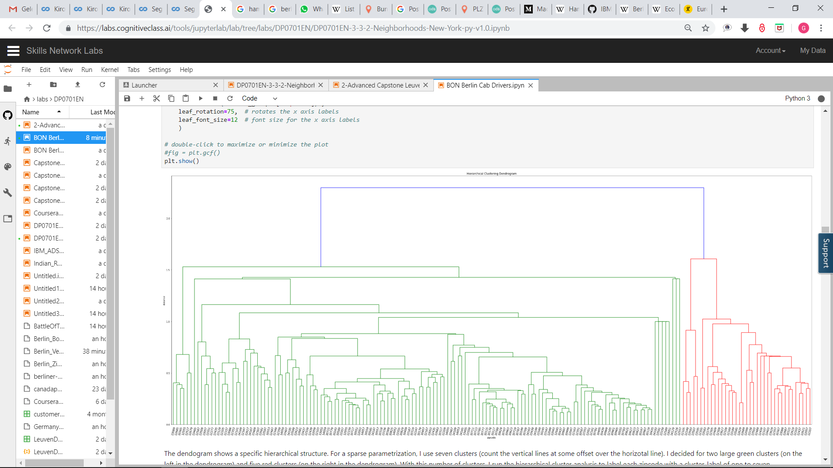
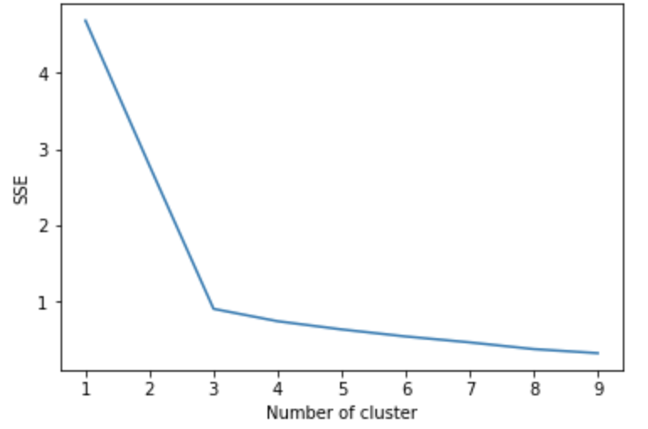
Data : General Overview
Four Square API Calls to Collect Neighborhood Venue Category and LAT/LNG
Cluster 1
One Hot Encoding to Convert Labels into Numbers
Venues Grouped by Neighborhood
K-Means Clustering
Cluster 2
Cluster 3
Dendogram
Elbow Method
Cluster 4
Cluster 5
Cluster 6
Cluster 7

